Slide 1
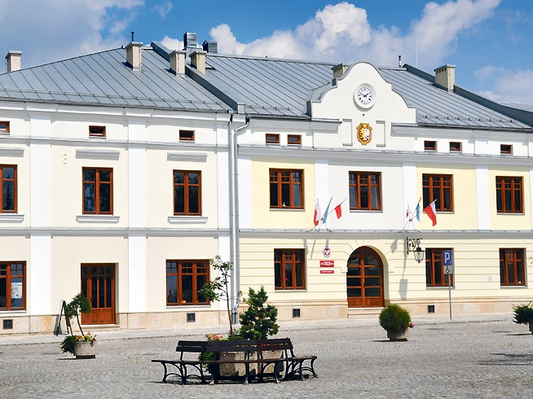
State University of Applied Sciences in Krosno
Notes:
1

Slide 2
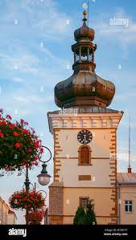
Our University
The first college was opened by the Jesuits in the 17th century.
Karpacka Panstwowa Uczelnia w Krosnie was founded in 1999.
It is an institiution of higher education offering 20 undergraduate degrees and 4 masters programmes.
Our university recently reached University status and has been renamed Panstwowa Akademia Nauk Stosowanych w Krosnie.

Slide 3
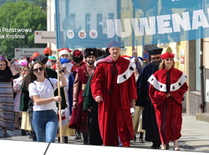
Students and graduates
Since the opening of Krosno State College in 1999, over 15000 students have graduated.
Over 2200 students attended our university in the 2022/2023 academic year.

Slide 4
Courses on offer
Our university has 3 different institutes Technology, Health, and Humanities and offers 20 different courses.
All of these institutes offer a range of courses more information about these can be found on the university website.

Slide 5
Kazimierza Wielkiego
This is the humanities building.
If you are studying a course under the humanities offer most your classes will take place here.
It is located across the Rynek and is the oldest building of the campuses.

Slide 6
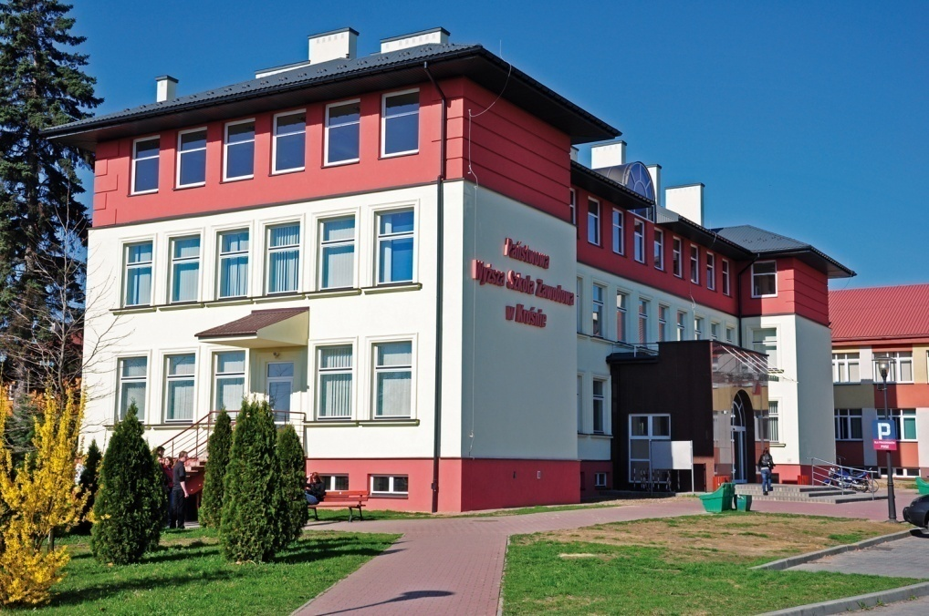
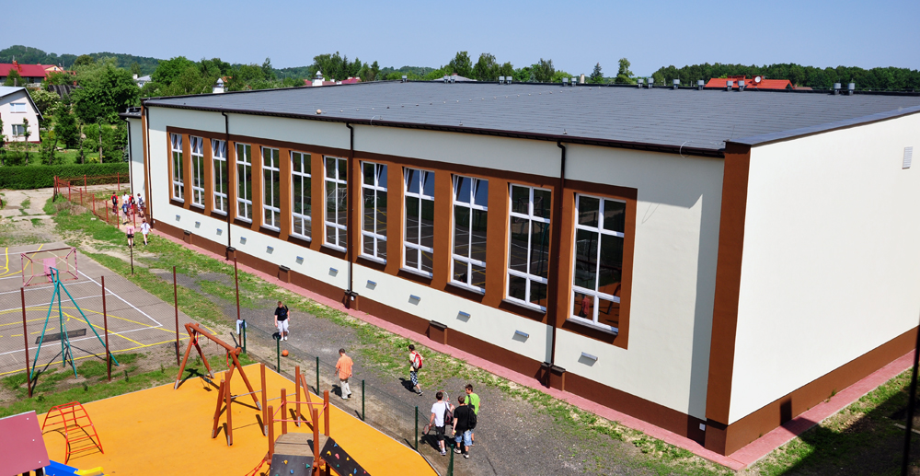
Turaszówka
This is the campus for Mechanics and Machine Constraction, Informatics, Physical Education , Tourism and Recreation
There are a few buses you can take to get here, these include bus number 2, 16, A, and B

Slide 7
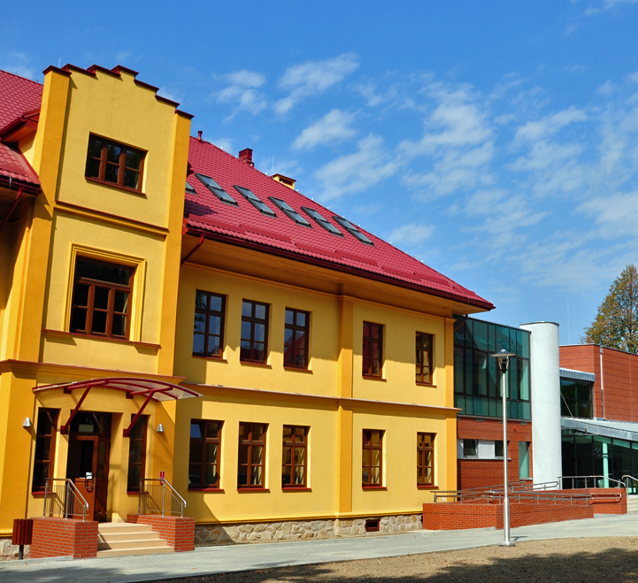
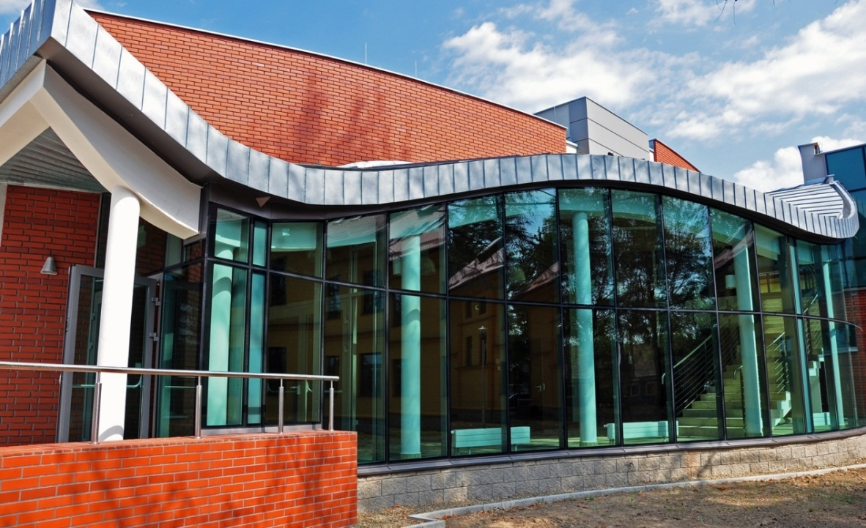
Dmochowskiego
This is the building where Environmental Engineering, Civil Engineering, Commodity Studies, Power Engineering, Regional Economy and Agroturism.
The easiest way to get here is by bus number 2

Slide 8
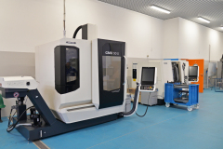
Żwirki i Wigury
This building has laboratories, lecture halls.
But it is also where one of the dormitories is located.
The best way to get here is via the number 0, or 10 bus, alternatively one can walk. This would take up to 30 minutes.

Slide 9
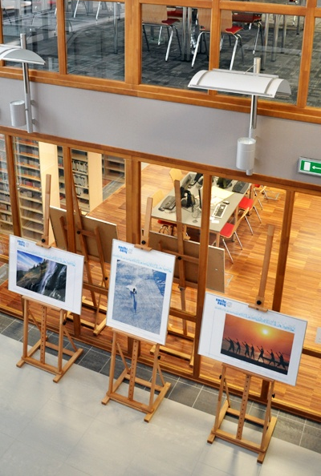
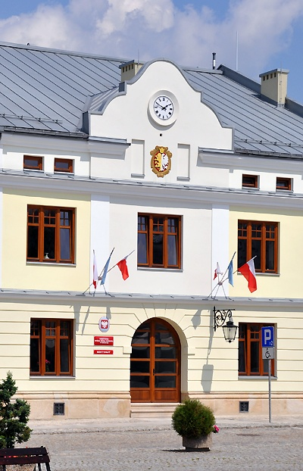
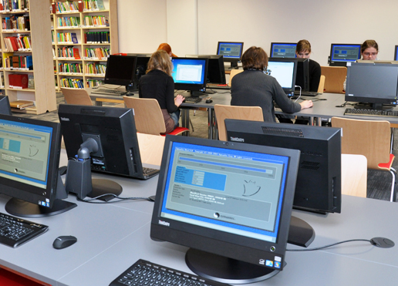
Rectorate building and Library
Here you will find the international office in room number 4 and also the kasa room number 103. If you are paying rent by cash, you pay here.
You can also walk through this building for easy access to the library which is located in the courtyard behind the building.
The library is a quiet place to complete work and study that you might have.

Slide 10
Our University’s outgoing Erasmus program
We are very proud of our international office as it give staff and students the opportunity to study and work abroad.
Each year we send abroad:
5-20 students for studies,
10-25 students for internships,
20-30 academic teachers,
15 administrative Staff for training
Notes:
As we are relatively small College, we have quite extensive international exchange. We support our students, both academic and administrative Staff in foreign actions. While there is a demographic crisis in Poland and total number of students lowers in whole country and in Krosno, we are able to maintain high level of exchange. Previously, more students were focused on their studies abroad, now, we have tendency for more internships and desire for more practical experience.
We adapt our support for students and Staff to use granted funds from National Agency at the best level. Most of our students choose Spain as their destination. In last few years, our students chosen also Greece, Italy, Germany, Austria, Croatia, Slovenia, Sweden, Latvia, Northern Ireland, but as you know from previous slides we can offer much more.
10

Slide 11
International agreements (Erasmus+ and bilateral)
We have a very strong and active international cooperation with agreements world- wide. Some of these include…
Over 70 agreements in 18 Erasmus+ Program Countries (Austria, Bulgaria, Croatia, France, Germany, Greece, Hungary, Italy, Latvia, Netherlands, Northern Ireland, Macedonia, Portugal, Romania, Slovakia, Slovenia, Spain, Sweden, Turkey)
2 partner universities in USA
3 partner universities in Ukraine
Notes:
This year our international cooperation reached an all-time high with the number of agreements in place with other universities. And we will continue to grow as we aim to make more agreements with universities world-wide.
11

Slide 12
Partner of Excellence
Notes:
One of our most important Global Partners in Education is East Carolina University. In 2015 we were awarded with the title of „Partner of Excellence” as their best Partner University among 62 institutions taking part in the project. . Global Partners in Education is a virtual programme that consists of online student classes. The Programme allows the group to connect with students in universities world-wide. Some of these countries include USA, China, Nigeria, Brazil. This gives the students an opportunity to communicate with different students and explore different cultures. Success of this project, has allowed us to expanded our cooperation. We now offer student exchange and intensive summer courses for American students.
12

Slide 13
Notes:
The Erasmus+ program began in Krosno in 2006. since then, we have expanded and grown significantly. Above are some of the logos of our Partner Universities located worldwide
13

Slide 14
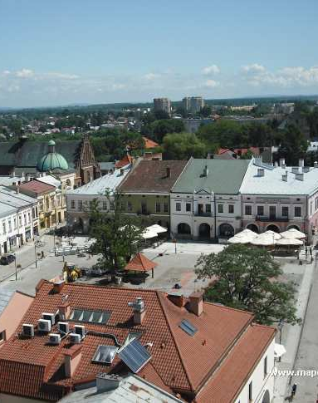
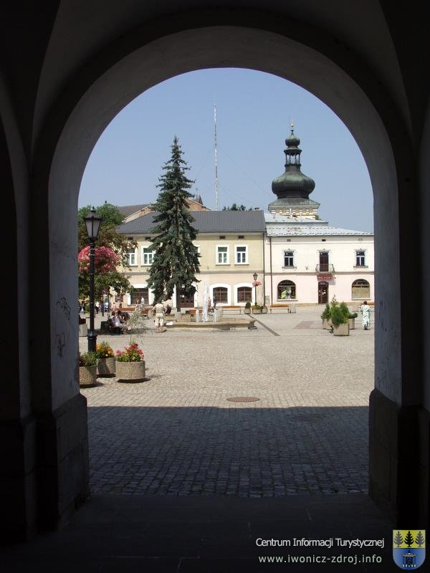
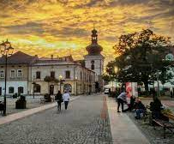
Krosno

Slide 15
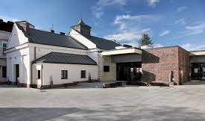
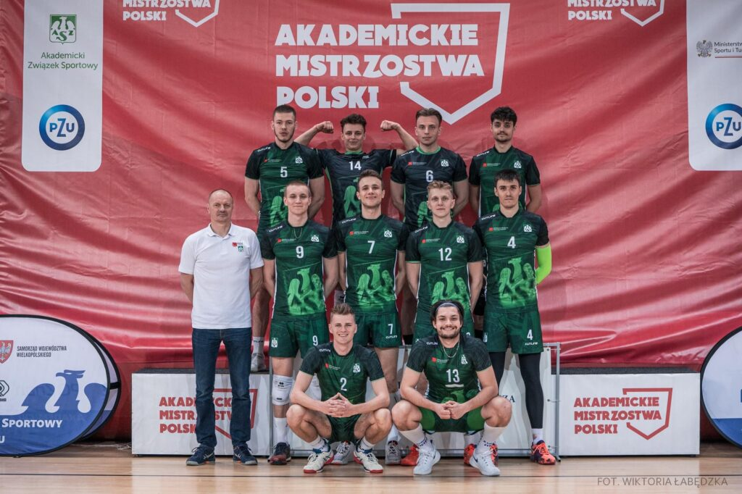
Free time in Krosno
Notes:
Krosno has a variety of restaurants and cafes.
We also have sports teams in our university and would encourage you to sign up and join our team.
Glove is a food delivery service that operates the area
We have a shopping centre called vivo about a 25-minute walk from the Rynek, there is a cinema locate
And we also have a McDonalds and a KFC
Sport
Swimming pool
Gyms
Basketball, Volleyball
Football, Table tennis
Culture
Cinemas
Herritage glass center
Museums
Night life, meals
Bars and clubs
Restaurants

Slide 16
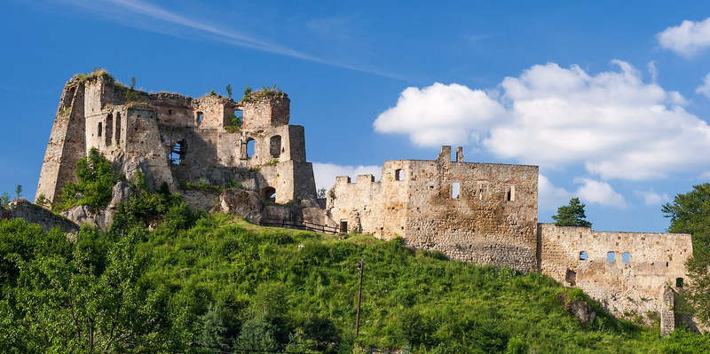
Some of Krosno’s surroundings
Notes:
Some examples of activities to do in Krosno and the surrounding area include,
Rynek – Market square – this is the City Centre and there are a number of Restaurants and cafes located here.
Glass Heritage Center – this is a place where you can learn about famous glass works in the city, its history, production processes and more – you can also blow glass by yourself!
Bóbrka Oil Mine – first oil mine in the world – place where Ignacy Łukasiewicz invented way to extract kerosane from oil, only 15km from city center.
Odrzykoń castle – ruins of 13th century castle, 8km north from city center – interesting place and example of border castles set up by Caismir the Great.
Krosno is also located about a 45 minute drive from Slovakia which is ideal for day trips.
Thermal baths are also located about 3.5 hours away from krosno.
Skiing is an option in winter

Slide 17
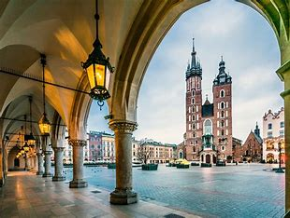
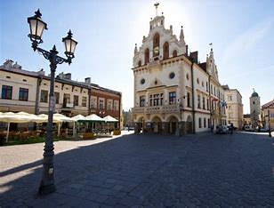
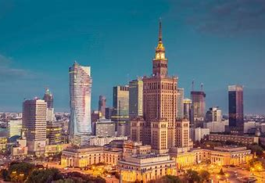
Traveling Poland
Krosno is a middle-sized town located in the southeast of Poland. It has good public transport with trains and buses to larger cities such as Krakow, Rzeszow and Warsaw.
This will give you the opportunity to travel when time allows and see what Poland has to offer

Slide 18
Thank you for listening
Any Questions?

